Slide 1
The impact of income volatility on financial decision making
Nathan Wang-Ly
Lab Talk – 24 Mar 2023

Slide 2

What is income volatility?
Stable incomes
Volatile incomes
Income
Income
Week/Fortnight/Month
Week/Fortnight/Month

Slide 3

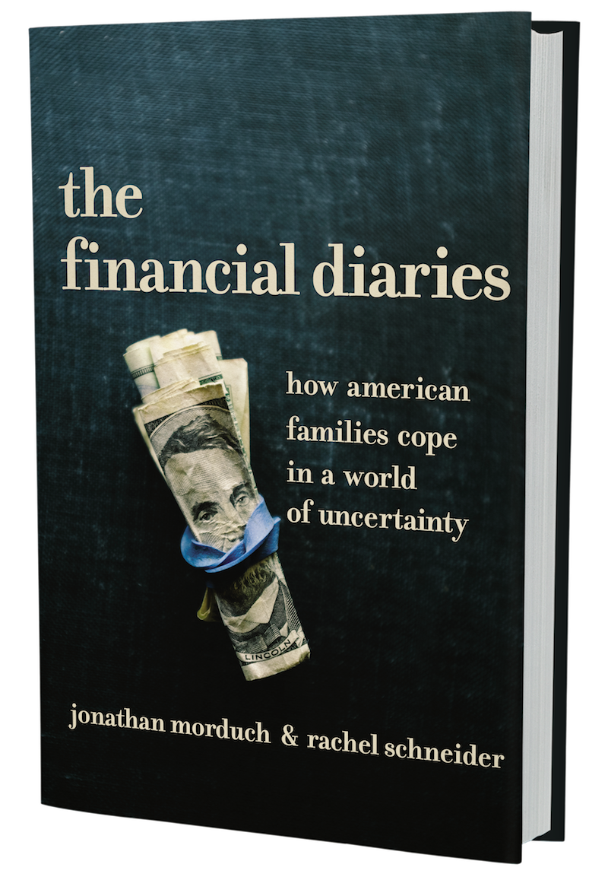



What makes income volatility interesting?
Financial decision making is hard.
People must balance spending in the present against saving for the future.
Anecdotal evidence suggests that income volatility increases the challenge of financial decision making—especially for those of low SES.
People struggle with moments of illiquidity and maintaining discipline with savings habits.
Insecure work is becoming increasingly common in Australia.
This includes casual jobs, contract roles, and gig work.

Slide 4


Previous research has focused on ‘inter-year’ volatility rather than ‘intra-year’
Inter-year volatility refers to changes in income from year to year
Intra-year volatility refers to changes within the year (e.g., weekly, fortnightly, monthly)
Presumably this is because studies can exploit large-scale panel surveys that collect responses on an annual basis
Inter-year volatility has been linked to both health (depression) and financial (greater likelihood of defaulting on mortgage) outcomes
Panel Study of Income Dynamics (PSID)
Current Population Survey (CPS)

Slide 5
Only recently have researchers begun examining intra-year income volatility
West et al. (2020)
Income volatility increases financial impatience
Peetz et al. (2021)
The role of income volatility […] in financial planning decisions
Provided income spikes to Kenyan participants via unconditional cash transfers
Received 3 weekly transfers of KSH 500 (~USD 5)
Measured financial impatience via adapted ‘multiple-price list’
E.g., KSH 500 today / KSH 510 in 6 months
Participants who received cash transfers were more financially impatient
More frequently chose ‘impatient’ option
Participants received hypothetical income for completing simulated work tasks
“Stable” income: Same income for each task completed
“Volatile” income: Income varied for each task completed
At end of task, all participants were offered a choice between USD 15 immediately or USD 17 in two weeks
Participants who experienced income volatility were less likely to choose the delayed payout

Slide 6
Where does that leave us?
Two key takeaways:
1
There is preliminary evidence suggesting that experiencing income volatility results in ‘poorer’ financial decision making.
2
However, experimental work is scarce and there remain many fruitful avenues for future research.
How much does income need to fluctuate by to be considered volatile?
What other financial decisions would be influenced by the experience of volatile income?

Slide 7
Experiment 1 Manipulating income volatility in a hypothetical spending/saving task

Slide 8
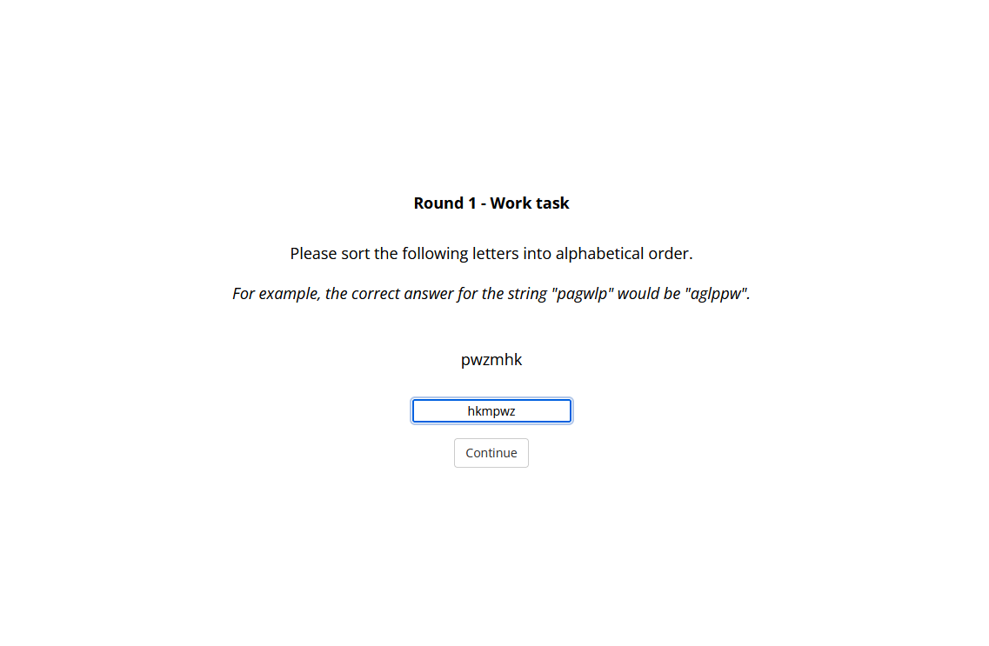
About the task: Working for income
Participants had to complete work task to progress (unlimited attempts)
Upon completion, participants received hypothetical income
No volatility: £1,000 each round
Low volatility: £431 - £1,340 (CV* = 0.3)
High volatility: £173 - £2,088 (CV* = 0.6)
Total income was constant between conditions
Order of incomes were randomised within each condition
* CV (coefficient of variation) = SD / Mean

Slide 9
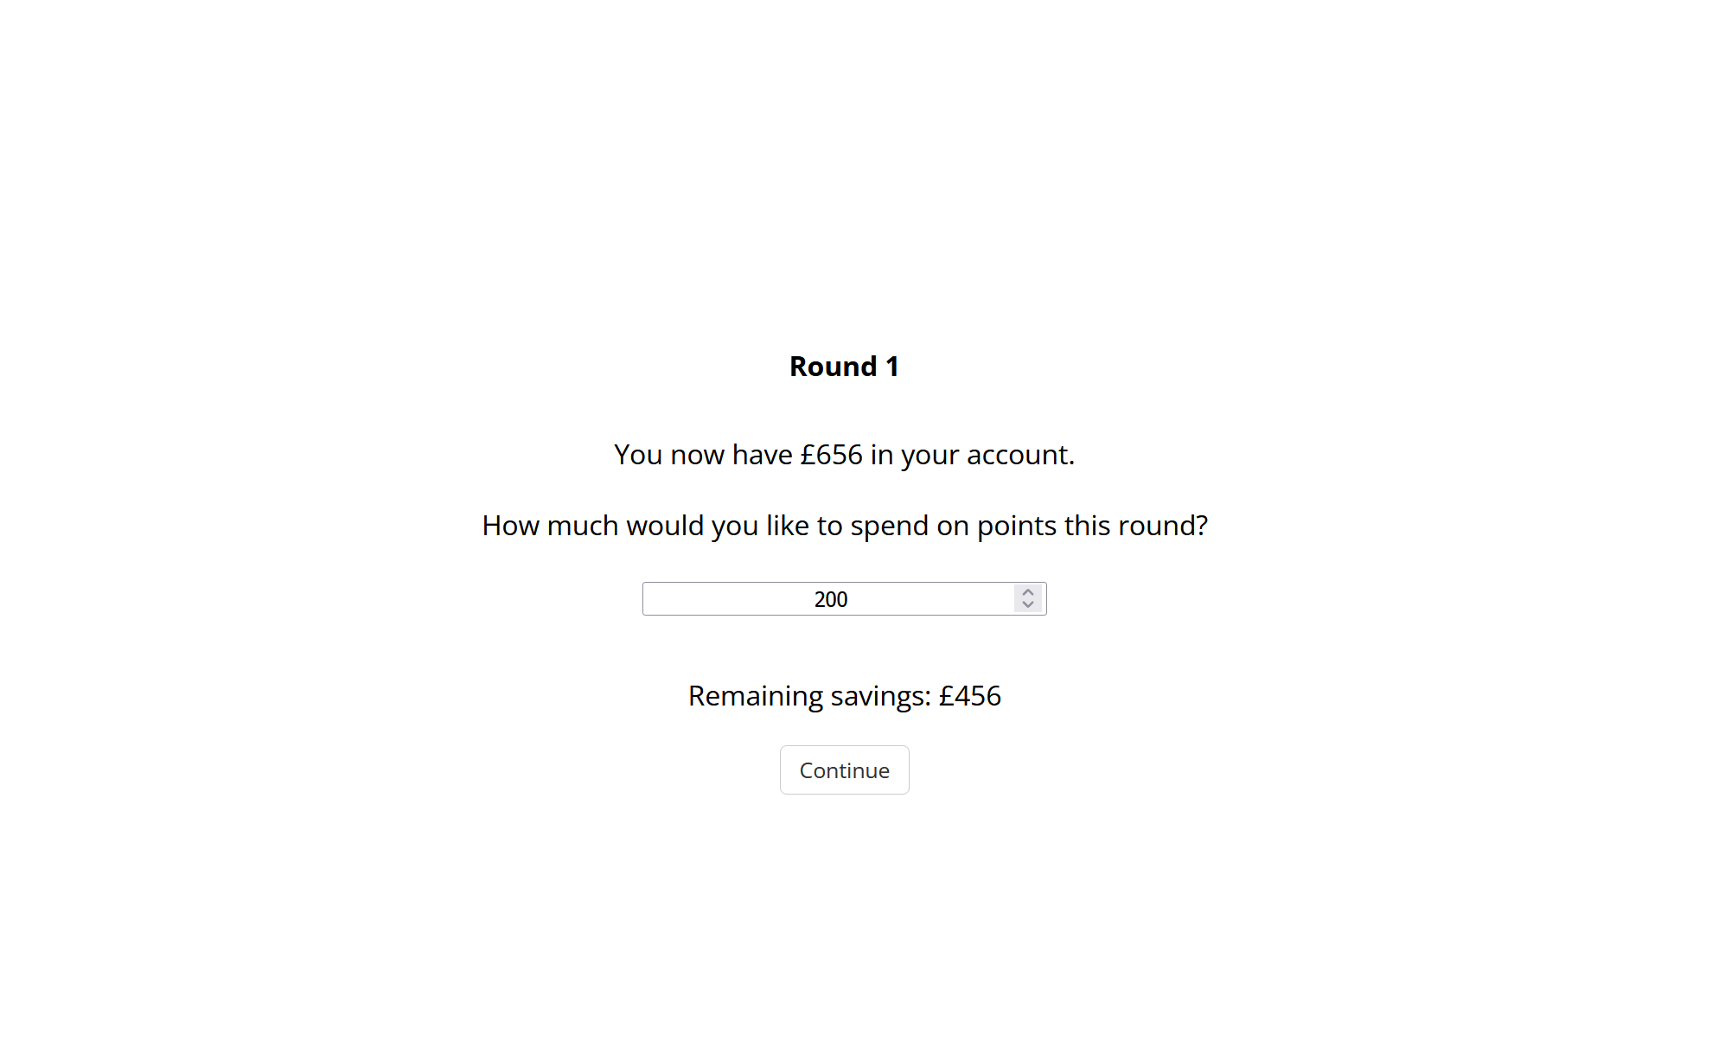
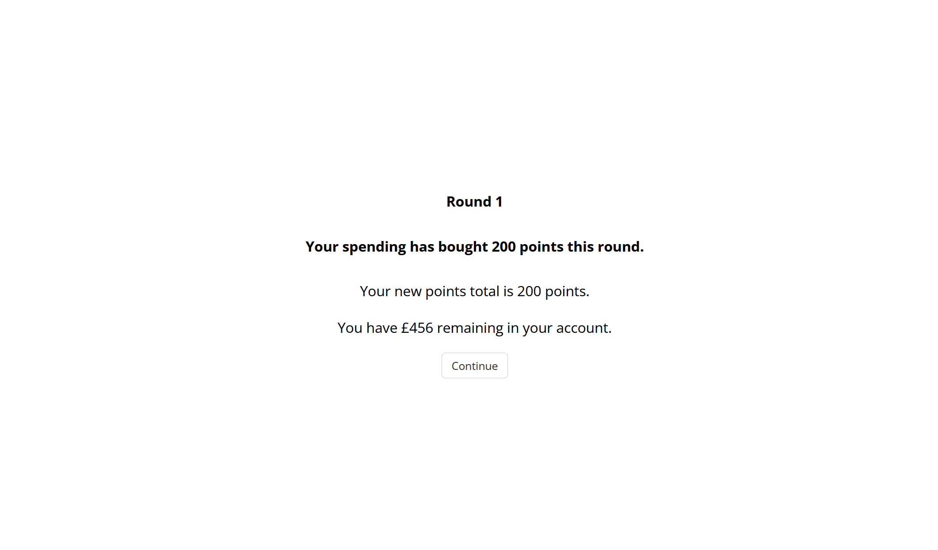
About the task: Spending vs saving
Participants decide how much of their income to allocate towards buying points
Any money that isn’t spent is carried over to the next round

Slide 10

About the task: The financial emergency
At the end of the task, participants were hit with a financial emergency (storm damage to their home)
Game outcome was determined by whether participants had enough saved to withstand the emergency
Participants with enough savings kept their points
Points used to select winners of bonus payments (top 10% of participants)
Participants with inadequate savings lost all points
Participants were aware that financial emergency would occur but not when or how much it would cost
Always occurred after round 15

Slide 11
Procedure
Task instructions
Practice rounds (x3) and financial emergency
Experiment rounds (x15)
Measures of perceived volatility, difficulty, and financial impatience
Financial emergency
Demographics/Financial situation questionnaire

Slide 12
Dependent measures
Primary DV
Final savings: Savings at end of task (round 15)
Secondary DVs
Perceived volatility: On a scale of 0 to 10, how volatile do you think the income you received in this task was?
Perceived difficulty: On a scale of 0 to 10, how difficult did you find it to decide how much to spend or save each round?
Financial impatience: Imagine that you were given the choice between two bonus rewards for participating in this experiment.
Option 1: Get paid a bonus payment of £50 in two weeks’ time.
Option 2: Get paid £X today.
What is the lowest amount you would accept to get paid today instead of two weeks from now?

Slide 13
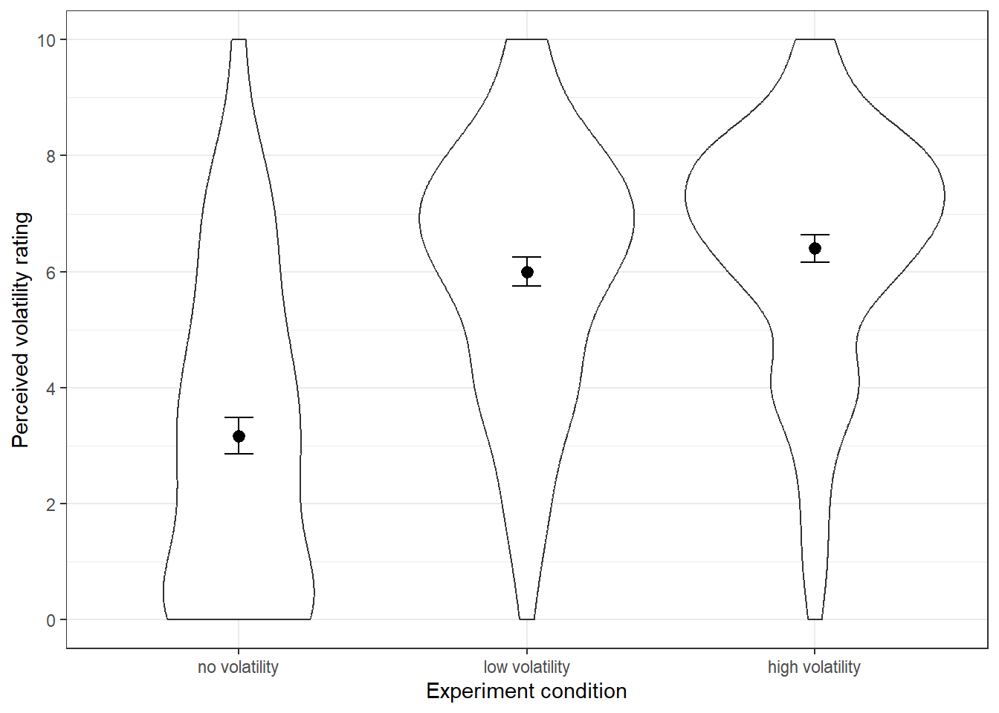
Results: Perceived volatility
Significant difference in perceived volatility between No vs Low and No vs High (p’s < .001)
Non-significant difference between Low vs High (p = .29)

Slide 14
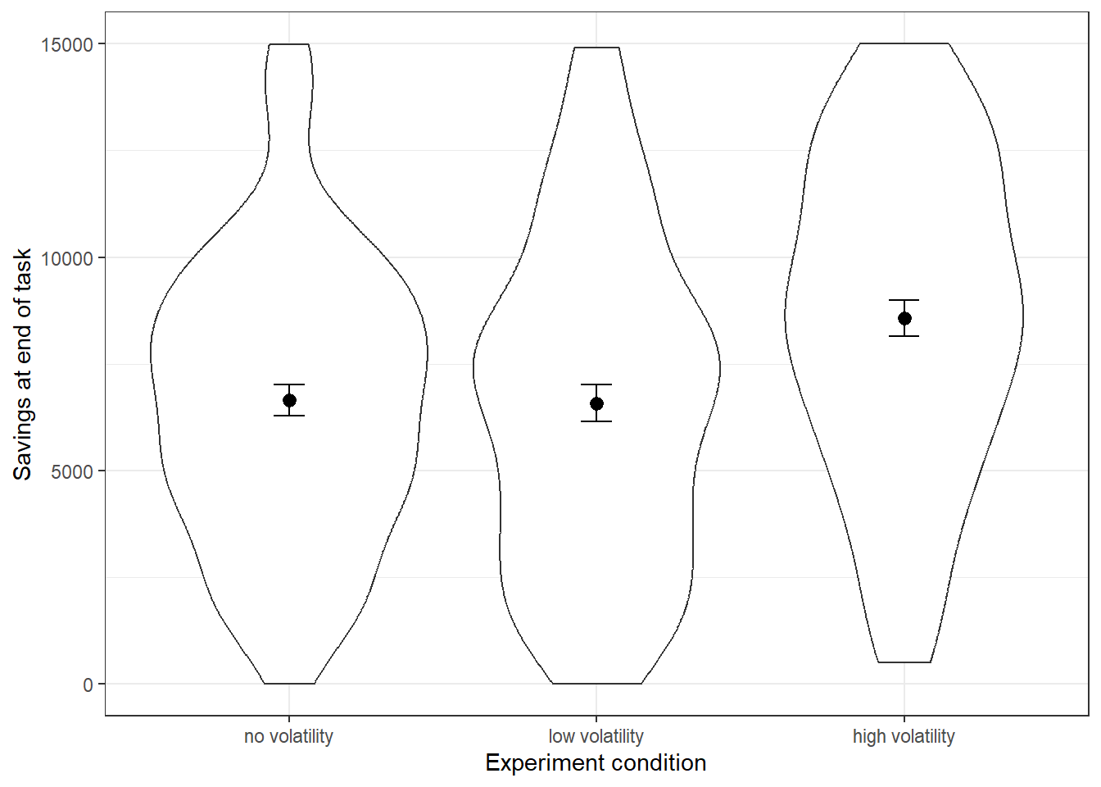
Results: Final savings
Significant difference in final savings between High vs No and High vs Low (p’s < .001)
Non-significant difference between No vs Low (p = .91)
Perceived volatility was negatively associated with final savings, but was not significant (p = .15)

Slide 15
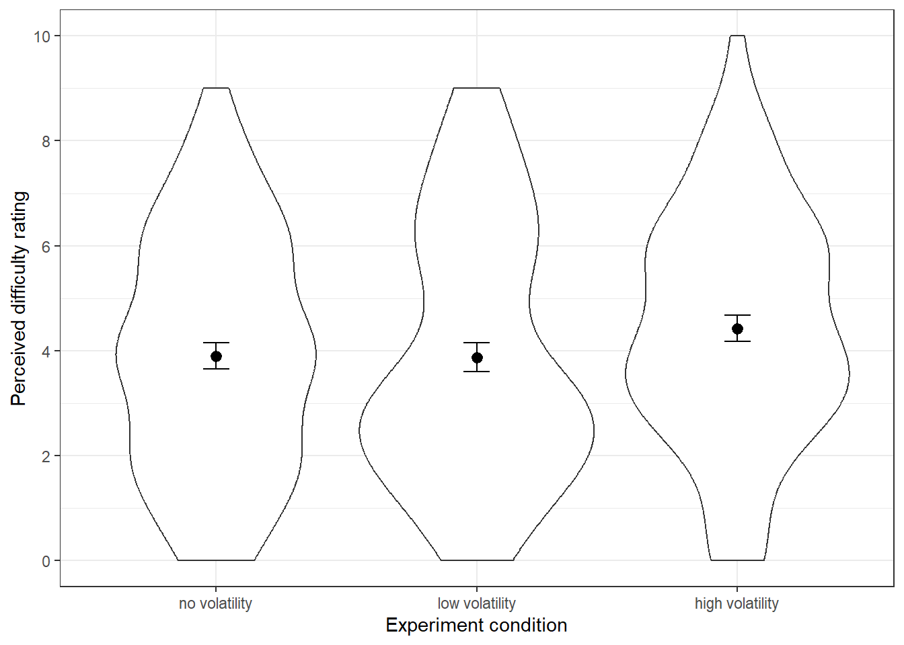
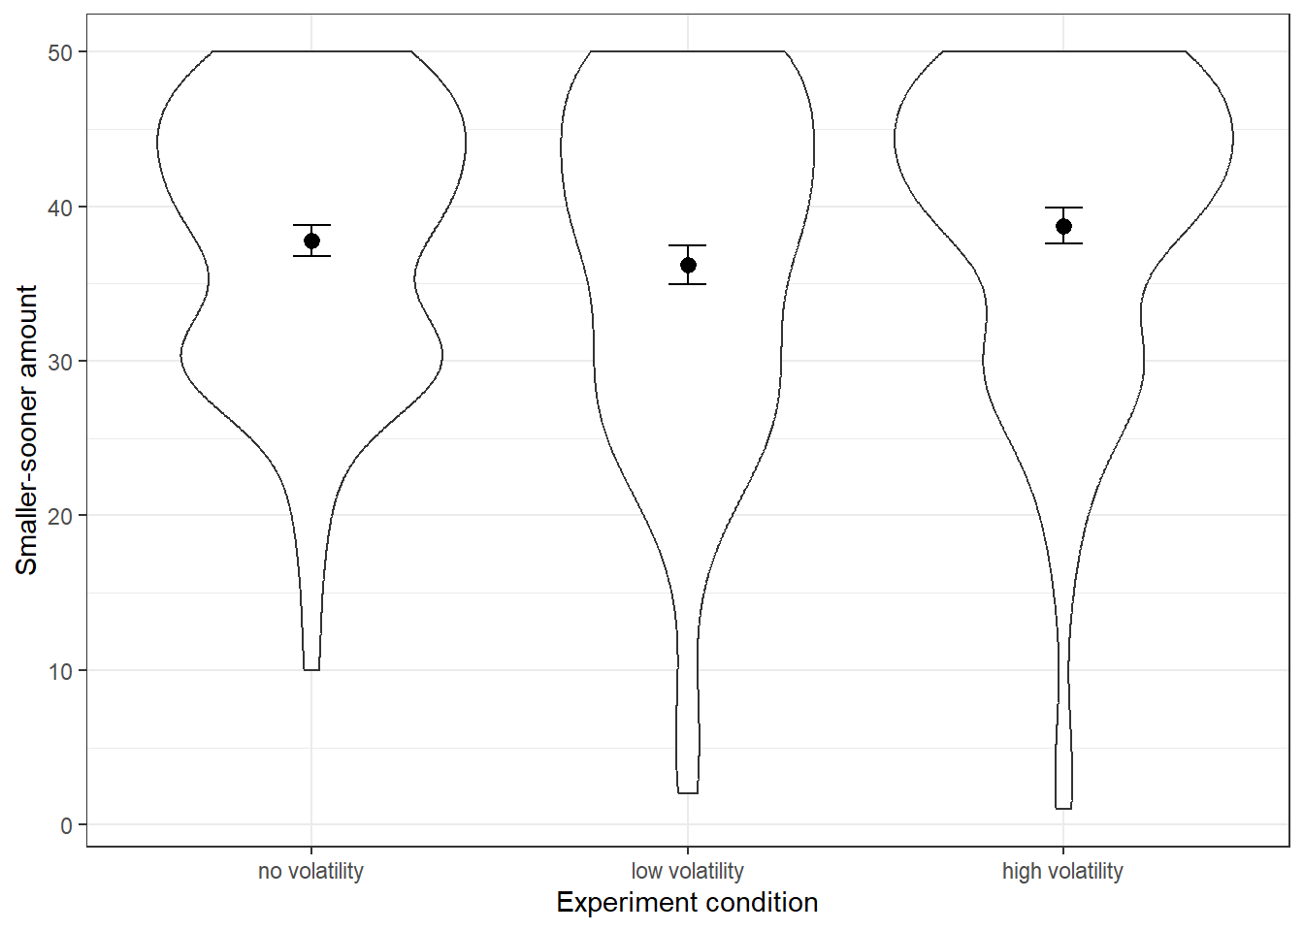
Results: Difficulty and financial impatience
No significant differences in ratings of task difficulty (p’s > .14)
No significant differences in preferred ‘smaller-sooner’ amount (p’s > .12)

Slide 16
Summarising Experiment 1
Interpreting the results of the No Volatility and High Volatility conditions is straightforward
1
Aim for Experiment 2
Participants in the High Volatility condition perceived their income as more volatile and saved more within the task.
Explore why participants’ perceptions of volatility do not map onto their behaviour within the task
Consider whether volatility (as defined by CV) may not be the underlying driver of participants’ behaviour
Disentangle CV from other characteristics of income sequence (e.g., min/max, range)
However, the results of the Low Volatility condition are less intuitive
2
These participants perceived the income to be as volatile as the High Volatility condition but displayed similar savings behaviour to the No Volatility condition.

Slide 17
Experiment 2 Disentangling related measures of volatility

Slide 18
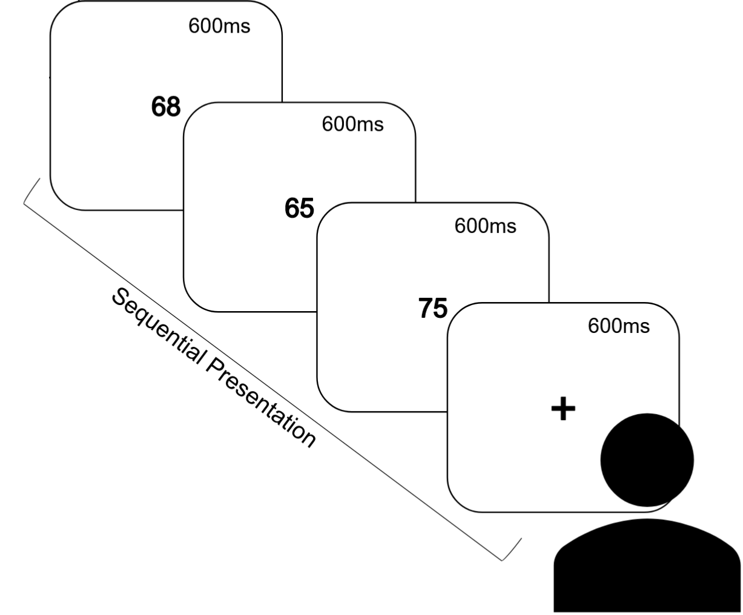
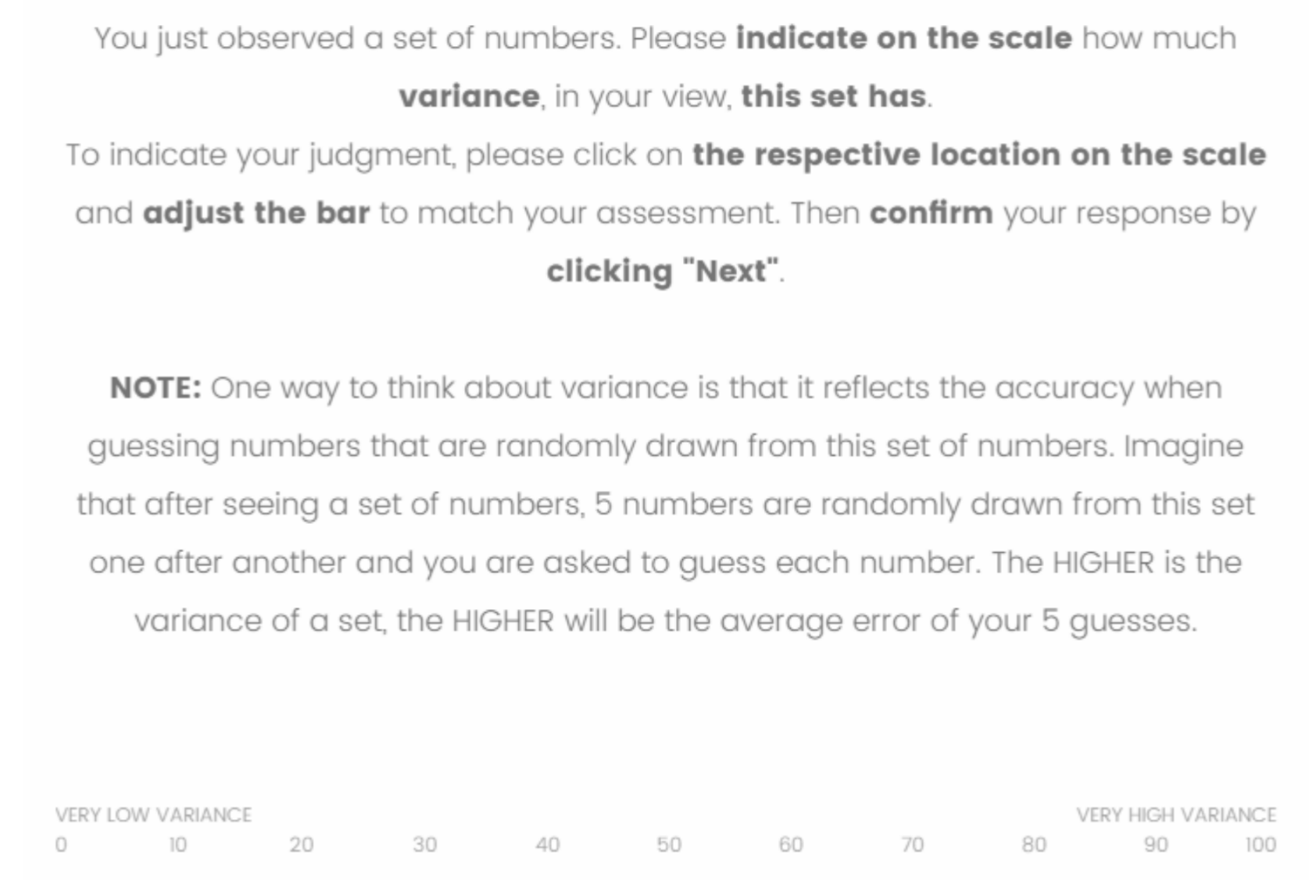
Related work by Konovolova & Pachur (2021)
Method
Findings
Presented participants with various number sequences
Elicited judgments of variance from participants
A series of regression models were used to compare the relative importance of different dimensions in predicting variance judgments.
Several dimensions of the sequences were better predictors of perceived variance than statistical variance
Variety, range, pairwise distance
The best model contained variety and pairwise distance
1
2

Slide 19
Income sequences in Experiments 1 & 2
Experiment (Condition) | Sequence | Coefficient of Variation (CV) | Min | Max | Range | Pairwise Distance | Variety
1 (No volatility) | 1,000 1,000 1,000 1,000 1,000 1,000 1,000 1,000 1,000 1,000 1,000 1,000 1,000 1,000 1,000 | 0.00 | 1,000 | 1,000 | 0 | 0 | 1
1 (Low volatility) | 431 570 656 794 873 883 910 990 1,158 1,202 1,277 1,279 1,311 1,326 1,340 | 0.30 | 431 | 1,340 | 909 | 72,848 | 15
1 (High volatility) | 173 274 466 526 529 650 661 847 1,101 1,374 1,404 1,436 1,571 1,900 2,088 | 0.60 | 173 | 2,088 | 1,915 | 147,356 | 15
2 (Same range) | 173 881 911 929 946 952 956 981 989 996 1,022 1,041 1,063 1,072 2,088 | 0.37 | 173 | 2,088 | 1,915 | 64,432 | 15
2 (Same min) | 173 552 654 851 863 864 889 1,017 1,036 1,211 1,240 1,257 1,310 1,503 1,580 | 0.37 | 173 | 1,580 | 1,407 | 89,724 | 15
2 (Same max) | 681 689 746 767 772 782 785 816 983 994 1,029 1,242 1,275 1,351 2,088 | 0.37 | 681 | 2,088 | 1,407 | 79,036 | 15

Slide 20
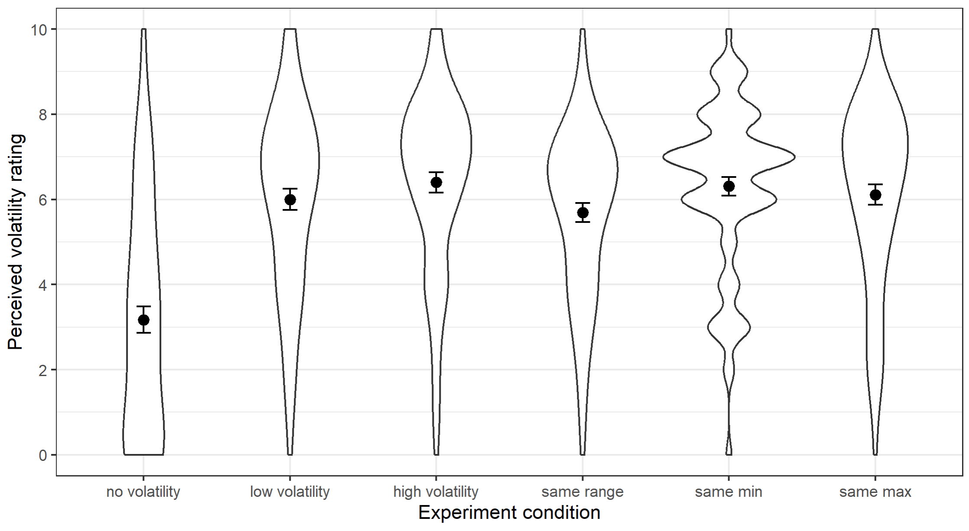
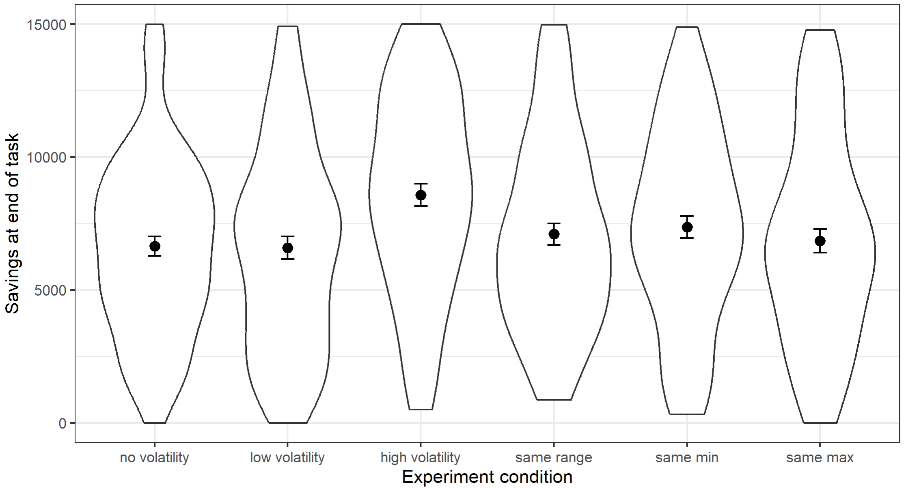
Results: Perceived volatility & final savings
Perceived volatility ratings across all conditions
Final savings across all conditions

Slide 21
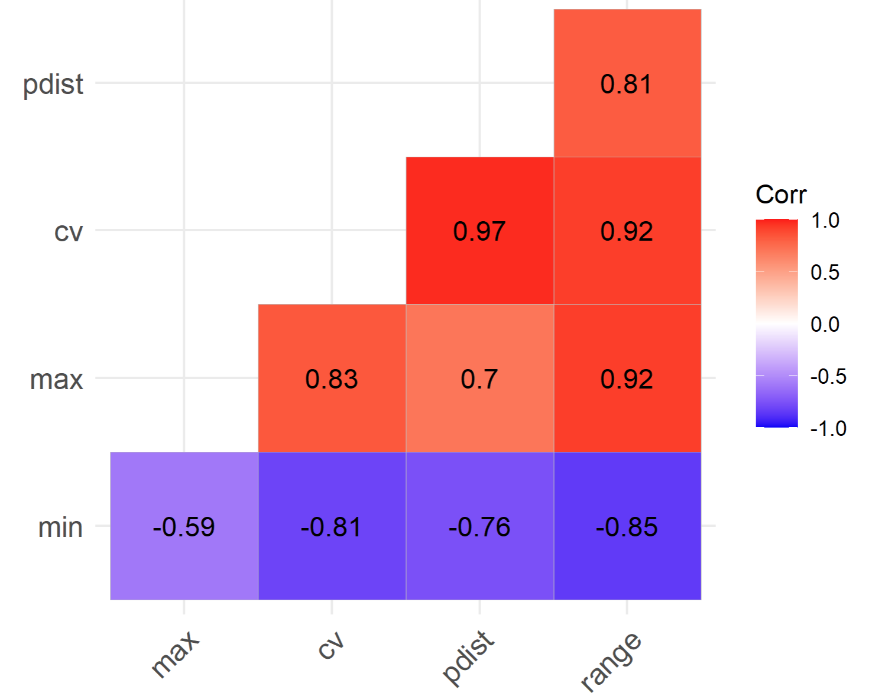
The challenge with running a multiple regression with all dimensions
Dimensions of interest are naturally highly correlated
Multicollinearity makes it difficult to isolate the effect of any one dimension

Slide 22
Alternative approach #1: Simple regression
Conduct regressions with one predictor at a time
Dimension | RMSE (Perceived volatility) | RMSE (Final savings)
Coefficient of Variation | 2.271 | 3,721.09
Min | 2.316 | 3,735.61
Max | 2.353 | 3,740.28
Range | 2.300 | 3,733.08
Pairwise Distance | 2.285 | 3,717.09
Use Leave-One-Out Cross-Validation (LOOCV) to test model accuracy
Compare root-mean-square error (RMSE) between models

Slide 23
Alternative approach: Pairwise comparisons
Perceived volatility
Comparison | Difference | Adjusted p-value
No Volatility – Low Volatility | -2.83 | <.0001
No Volatility – High Volatility | -3.23 | <.0001
No Volatility – Same Range | -2.51 | <.0001
No Volatility – Same Min | -3.14 | <.0001
No Volatility – Same Max | -2.94 | <.0001
Low Volatility – High Volatility | -0.40 | 0.86
Low Volatility – Same Range | -0.31 | 0.95
Low Volatility – Same Min | -0.31 | 0.95
Low Volatility – Same Max | -0.11 | 1.00
High Volatility – Same Range | 0.71 | 0.33
High Volatility – Same Min | 0.09 | 1.00
High Volatility – Same Max | 0.29 | 0.96
Same Range – Same Min | -0.62 | 0.48
Same Range – Same Max | -0.43 | 0.83
Same Min – Same Max | 0.20 | 0.99
Significant differences in perceived volatility ratings between No Volatility and all other conditions
No other significant differences observed between remaining conditions
Suggests insensitivity/diminishing sensitivity between different levels of volatility

Slide 24
Alternative approach: Pairwise comparisons
Final savings
Comparison | Difference | Adjusted p-value
No Volatility – Low Volatility | 68.3 | 1.00
No Volatility – High Volatility | -1,923.8 | 0.01
No Volatility – Same Range | -448.8 | 0.97
No Volatility – Same Min | -714.8 | 0.82
No Volatility – Same Max | -194.5 | 1.00
Low Volatility – High Volatility | -1,992.1 | 0.01
Low Volatility – Same Range | -517.1 | 0.95
Low Volatility – Same Min | -783.2 | 0.76
Low Volatility – Same Max | -262.9 | 1.00
High Volatility – Same Range | 1,475.0 | 0.12
High Volatility – Same Min | 1,208.9 | 0.31
High Volatility – Same Max | 1,729.2 | 0.04
Same Range – Same Min | -266.0 | 1.00
Same Range – Same Max | 254.2 | 1.00
Same Min – Same Max | 520.3 | 0.95
Significantly higher savings in the High Volatility condition compared to most other conditions
Could attribute to higher CV (0.6 vs 0-0.37)
However, non-significant differences between High Volatility and Same Range/Same Min condition—which also have CV of 0.37
Suggests that CV and the minimum income may have a combined effect on savings decisions within the task

Slide 25
Concluding thoughts
1
Experiencing income volatility influenced participants’ spending/savings decisions in our financial decision-making task.
Participants tended to save more, perhaps as a conservative response to not knowing their future income
However, there was no influence on their ‘financial impatience’ (contrary to previous work)
2
There appears to be a discrepancy between what participants perceived as volatile and what impacted their decisions.
Participants in the Low Volatility, Same Min, and Same Range conditions rated their income as volatile but did not behave differently to the No Volatility condition
This remains an avenue for investigation to be pursued further in Experiment 3

Slide 26
Thank you ☺

